Slide 1
Article 4 or 5 - M-District - Plus
MBTA-CA Compliance Plan: Livable Communities Advisory Committee, November 13, 2023 Presented by: Linda Olson Pehlke
Petitioners: Article 4: Select Board, Article 5: Linda Olson Pehlke, TMM P17, Susie Roberts, P17, Nancy Heller, P8

Slide 2
MBTA-CA Requirements
By-right zoning capacity for 6,990 units (25% of 27,960, 2020 Census).
Housing Suitable for Families.
Minimum size of 41 acres near rapid transit.
Zoning must be implemented by 12/31/2023.
Minimum Gross Density of 15 du/acre.
Not more than 0.5 miles from T stop.
No age restrictions.
Cannot mandate Commercial on Ground Floor (later partially allowed)

Slide 3
Complying with the MBTA Act – the M-District+ Plan
M-District+ Plan found in two identical warrant articles –
STM1, Articles 4 and 5
  Drafted to fully comply with the MBTA Act
Also part of Select Board “consensus plan”--STM4, Article 1
  Here, combined by Select Board with zoning changes on Harvard Street
  M-District+ Plan is necessary part to comply with MBTA Act

Slide 4
How did M-District Come About?
Planning Department proposed up-zoning Harvard St. and hiring a form—based zoning consultant to make Harvard St. our MBTA-CA compliance plan.
But, MBTA-CA guidelines were problematic on Harvard St.
Article 24 in Spring TM to create Moderator’s Committee to study alternative routes to MBTA compliance.
April 2023, Select Board appoints MBTA Multi-Family Permitting Committee: Chair, Dick Benka, Members: Ken Lewis, Katha Seidman, David Pollak, Carol Gladstone, Rick Fredkin, Linda Olson Pehlke, Neil Wishinsky, with support from Kara Brewton, PD. Held 16 public meetings, met May – August.

Slide 5
Key Features of M-District-Plus
It is an Overlay creating a by-right permitting process for Multi-Family housing. (multi-family defined as 3 or more units)
Objective Design Standards were created to assure that replacement structures will be compatible with existing neighborhood settings.
Property owners can choose to develop under existing zoning or they can meet the site plan and design review standards and go the by-right route.
Meets legal compliance requirements of the MBTA-CA many times over.
Includes proposals for additional BHA units @ Juniper/Walnut/High St. site. and expands allowable uses in Emerald Island to include multi-family.
Large Projects >30,000 sq.ft. not allowed by-right - Must get design review special permit

Slide 6
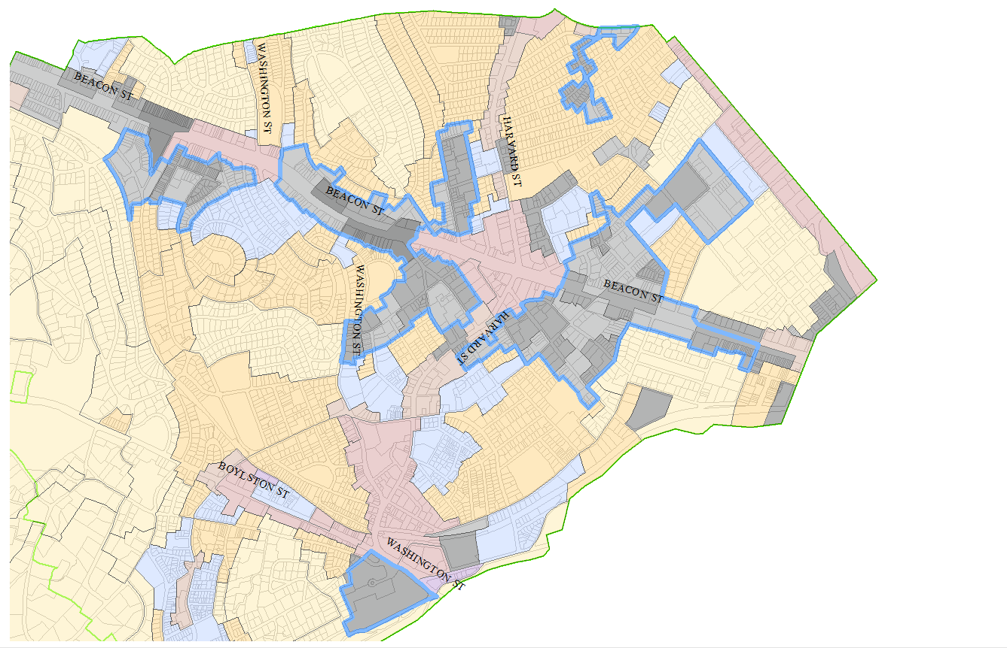
M-District-Parts of M-1.5, 2.0, 2.5
Multi-family districts as shown here outlined in Blue make up the
M-District Overlay.
Total Zoning Capacity of 8,182 residential units.

Slide 7
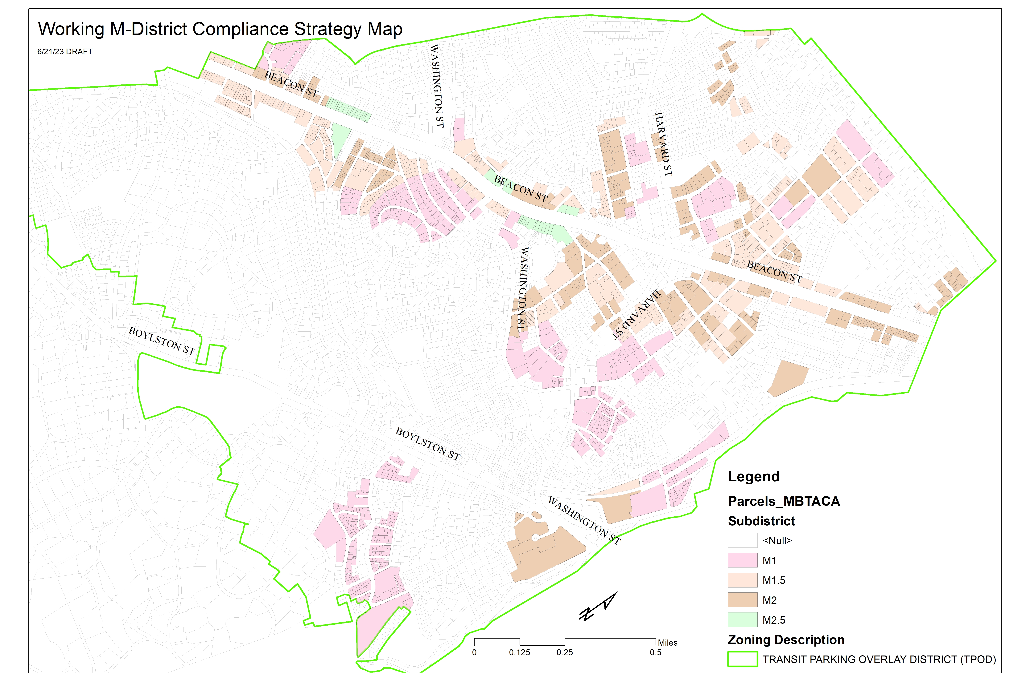
After considering alternatives, looked at all M-Districts
Map shows all M-Districts, from least dense (M-1.0 – FAR of 1; pink areas on map) to most dense (M-2.5 – FAR of 2.5) (“FAR” is building sf/lot sf)
Resulted in “capacity” of 16,000 units, well above required 6,990

Slide 8
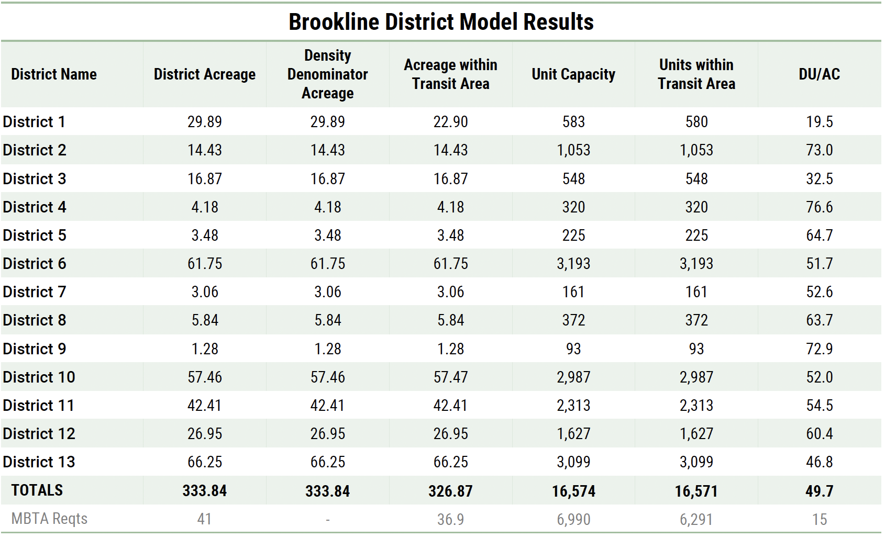
Existing Multi-Family Districts
Capacity = 16,574 Units
Area = 334 Acres
Density = 50 Units/Acre

Slide 9
What does “by right” mean in the MBTA Act?
  Zoning cannot include discretionary design review with ZBA special permits or variances
  But can apply “objective design standards”
  Explicitly can include “architectural design”
  Can also apply our dimensional requirements – lot size, setbacks, height, open space, floor area ratios (building sf/lot sf)
  Can also apply General By-Law provisions

Slide 10
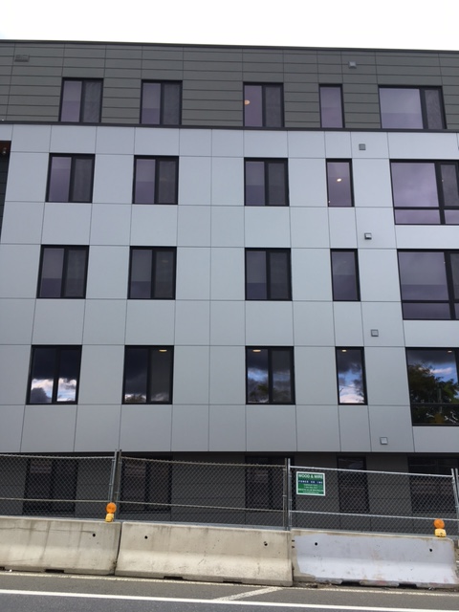
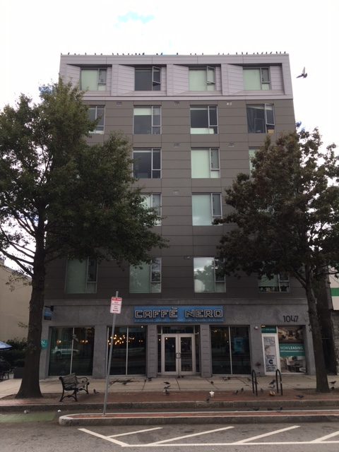
Does not permit “packing crates” with flat panels and “cookie cutter” windows

Slide 11
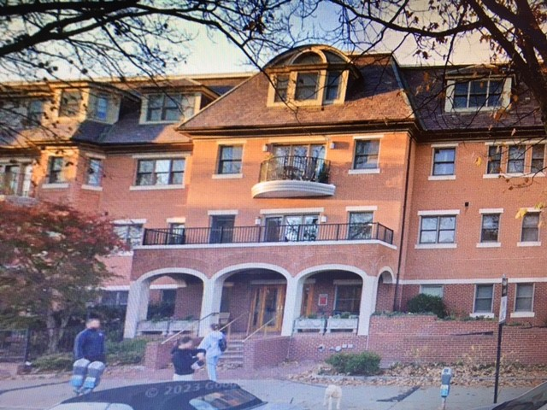
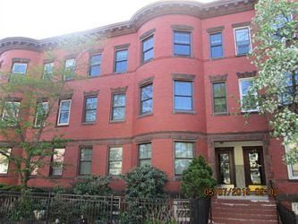
Encourage architectural design and materials consistent with existing neighborhoods

Slide 12
So what is the “+” of the “M-District+” Plan?
Brookline Housing Authority property – Walnut & High Streets
  Rezoning to permit 175 to 225 entirely new or entirely renovated units (number will depend on mix between senior and family units after public input)
  Close collaboration with the BHA and architects to define necessary zoning changes
  “As of right” zoning vs. need for special comprehensive permit
  Amendment to “Emerald Island” special district
  Between River Road and Brookline Avenue (Hilton Garden Inn to Brookline Ice & Coal)
  Would permit larger multi-family units in addition to micro-units, live-work, and senior
  No residential development in 6+ years; goal is to “unlock” the site to 80 – 115 units

Slide 13
Things to Keep in Mind
Harvard St. rezoning not needed for compliance.
M-District - Plus Proposal Meets MBTA-CA Metrics three times over.
Passage of M-District - Plus gives us flexibility – Harvard St. doesn’t need to comply.
M-District – mostly built out and overlay does not up zone.
Brookline added 1,512 housing units between 2010-2020 a 6% increase.
Brookline has already permitted an additional 1,325 housing units, a 5% increase
40B window was open – Town received one new 40B proposal 100 units-Chestnut Hill.
Housing growth of about 1,750 units with M-District alone, including BHA & Emerald Island.
Comprehensive Planning and zoning reform about to start. We need inclusive and informed decision making about our future. What is an appropriate rate of growth?

